Slide 1
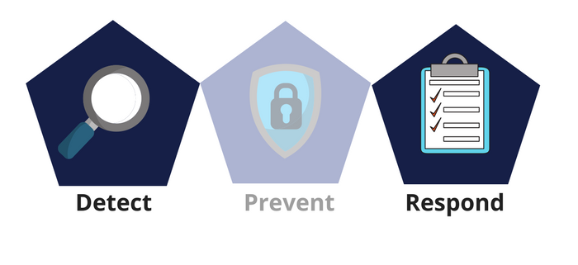



Network Security
Class X
lab 27

Slide 2


Exploitation
a piece of programmed software or script which can allow hackers to take control over a system

Slide 3
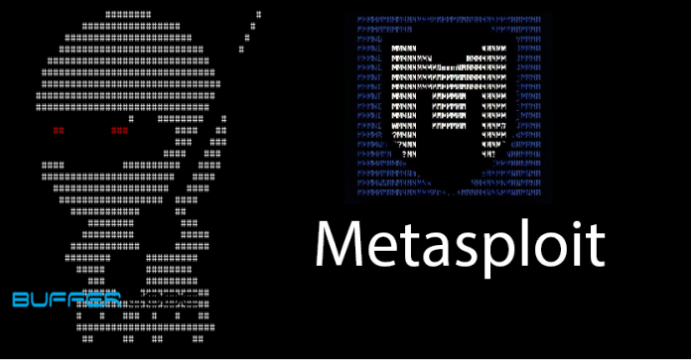
Metasploit
A powerful tool to locate
vulnerabilities in a system

Slide 4

Exploit Database
This is the place where you can find all the exploits related to a vulnerability

Slide 5
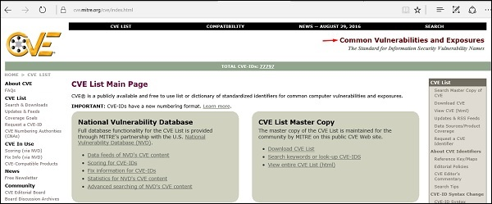
CVE
Common
Vulnerabilities
and Exposures
(CVE) is the
standard for information
security vulnerability names

Slide 6
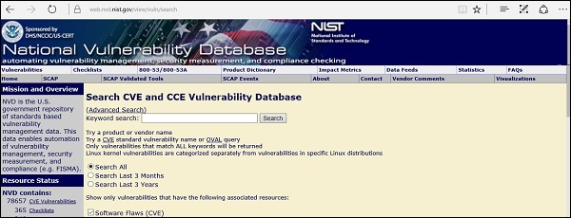
NVD
National Vulnerability Database (NVD) is the U.S. government repository of standards based vulnerability management data

Slide 7

Remote Exploits
Hackers use remote exploits to gain access to systems that are located at remote places

Slide 8
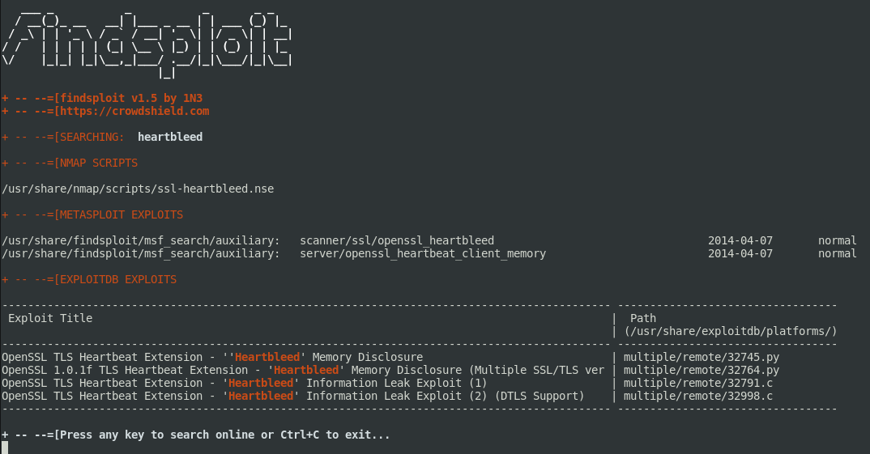
Local Exploits
generally used by a system user having access to a local system

Slide 9
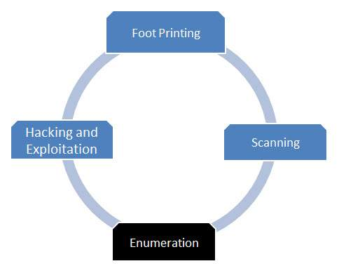
Enumeration
Enumeration belongs to the first phase of Ethical Hacking, i.e., “Information Gathering”.

Slide 10
Enumeration
Enumeration belongs to the first phase of Ethical Hacking, i.e., “Information Gathering”.

Slide 11
Thank You

